Slide 1

Bright tv viewership analytics
Prepared by : Boitumelo Tsotetsi Student Nr: 2805002206

Slide 2
Business objective
Grow bright tv’s user base
Understand who Bright TV’s customers are
Identify factors affecting viewing behaviour

Slide 3
Business objective continued…
Business Problem
Content:
The CEO of BrightTV has tasked the analytics team with understanding customer viewing behaviour in order to increase subscriptions and improve customer engagement.
The objectives of this analysis are to :
Understand who BrightTV’s customers are.
Identify when customers consume the most content.
Determine which content attracts the most viewers.
Identify factors affecting viewing behaviour.
Recommend strategies to increase customer engagement and subscriptions.

Slide 4
Dataset Overview
Key Performance Indicators | Value
Viewing Sessions | 10 000
Total Watch Hours | 1 523
Regions | 10
TV Channels | 17

Slide 5
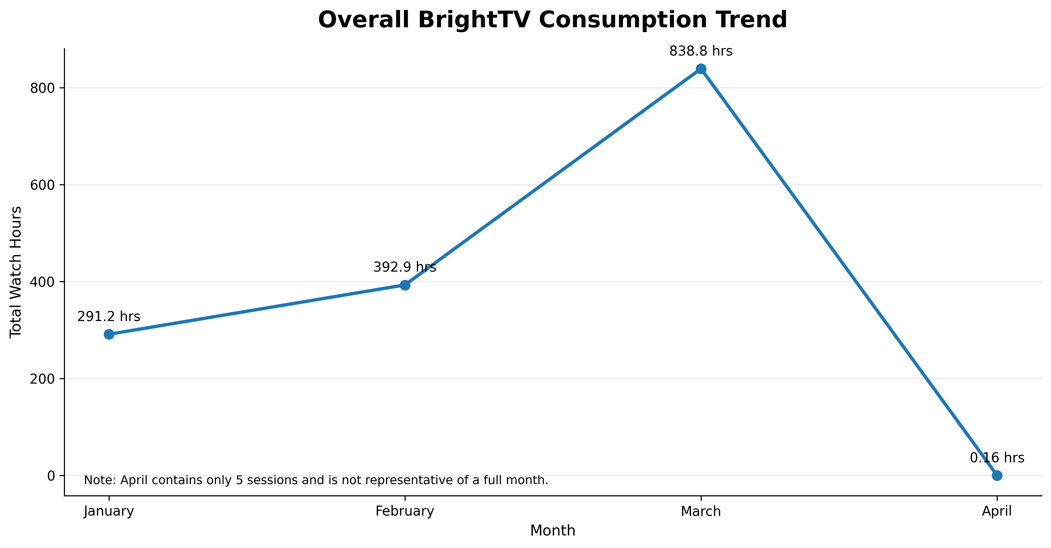
Overall Consumption Trend

Slide 6
Overall Consumption Trend continued…
BrightTV’s viewing increased significantly from January to March, with March recording the highest total consumption.
NB: April contains only 5 recorded sessions and therefore should be excluded from meaningful month-on-month comparison.

Slide 7
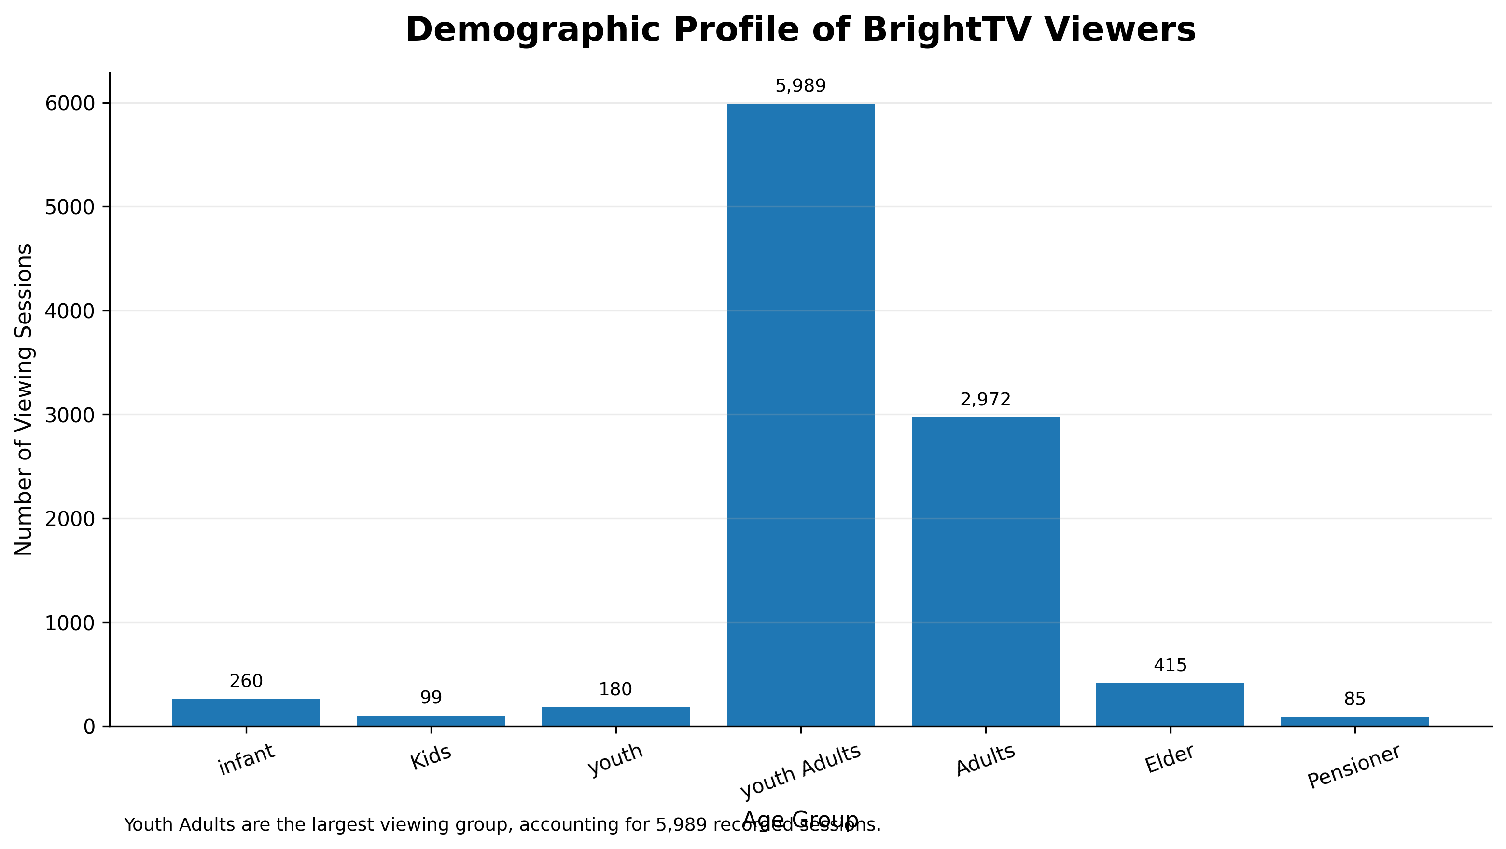
Who Uses Bright TV?

Slide 8
factors influencing consumption
Factor | Observation | Business Impact
Gender | Male viewers account for most sessions. | Consider investigating opportunities to grow female engagement.
Age | Youth Adults are the dominant audience. | Tailor content and marketing to this demographic.
Region | Gauteng contributes the most viewing. | Maintain investment while expanding in lower-performing regions.
Day | Saturday has the highest viewing. | Schedule major releases before weekends.
Time of Day | Evening dominates viewing. | Publish premium content in the evening.
Content | Sports and live events. | Continue investing in high-demand programming.

Slide 9
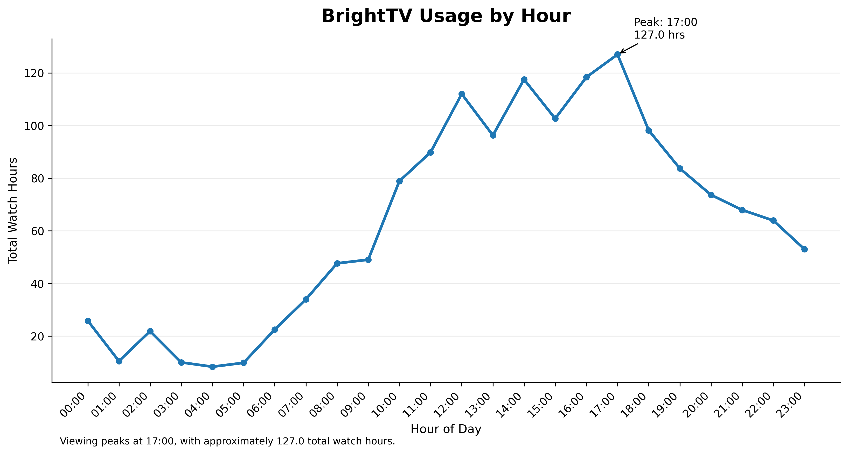
Usage by Hour

Slide 10
Usage by Hour continued..
The graph shows total watch hours across the 24 hours of the day. The peak occurs at 17:00, with approximately 127.0 watch hours.

Slide 11
Recommendations
1. Increase Engagement
Launch Monday engagement campaigns.
Promote high-performing content.
Use personalised recommendations.
Release premium content around peak viewing periods.
2. Increase Subscribers
Referral programme.
Youth Adult campaigns.
Regional acquisition campaigns.
Promotional/free-trial offers.

Slide 12
Growing Bright TV's User Base
Initiative 1 — Referral Programme
Existing subscribers receive a reward for referring friends, family, colleagues, etc.
Initiative 2 — Youth Adult Campaign
Because Youth Adults dominate consumption, we could create campaigns specifically for this group.
We can use:
Instagram
TikTok
Social media
Influencer marketing
Student promotions

Slide 13
Key Findings
Audience
Youth Adults are the dominant audience segment.
Content
Sports and live events are major consumption drivers.
Time
Evening is the strongest time-of-day viewing periods.
Day
Saturday is the highest-consumption day; Monday is the lowest.
Region
Gauteng contributes the highest viewing volume.

Slide 14
conclusion
BrightTV’s viewing data shows clear difference in consumption across audience demographics, regions, days and content types. Youth Adults represent the largest audience segment, Gauteng contributes the highest viewing volume, evenings generate the strongest consumption and Saturday is the strongest viewing day. Conversely, Monday represents an opportunity for increased engagement. Bright TV can use these insights to personalise content recommendations, strengthen sports and live-offerings, target high-value audience segment and introduce initiatives aimed at acquiring new subscribers.

Slide 15
Thank You
Any Questions?

